Slide 1
Chapter 2:
Access to Information
Jonathan Pevsner, Ph.D.
pevsner@kennedykrieger.org
Bioinformatics and Functional Genomics
(Wiley-Liss, 3rd edition, 2015)
You may use this PowerPoint for teaching purposes

Slide 2
Outline
Introduction to biological databases
Centralized databases store DNA sequences
Contents of DNA, RNA, and protein databases
Central bioinformatics resources: NCBI and EBI
Access to information: accession numbers
Access to information via Gene resource at NCBI
Command-line access to data at NCBI
Access to information: genome browsers
Examples of how to access sequence data: individual genes
How to access sets of data: large-scale queries of regions and features
Access to biomedical literature
Perspective

Slide 3
Learning objectives
After studying this chapter you should be able to:
■ define the types of molecular databases;
■ define accession numbers and the significance of RefSeq identifiers;
■ describe the main genome browsers and use them to study features of a genomic region; and
■ use resources to study information about both individual genes (or proteins) and large sets
of genes/proteins.

Slide 4
Outline
Introduction to biological databases
Centralized databases store DNA sequences
Contents of DNA, RNA, and protein databases
Central bioinformatics resources: NCBI and EBI
Access to information: accession numbers
Access to information via Gene resource at NCBI
Command-line access to data at NCBI
Access to information: genome browsers
Examples of how to access sequence data: individual genes
How to access sets of data: large-scale queries of regions and features
Access to biomedical literature
Perspective

Slide 5
Biological databases: two perspectives
We might want to study one gene, protein, DNA molecule, or other type of object in a database. For example, for human beta globin there is a gene (HBB), a protein sequence, a protein structure, and entries for various kinds of variation.
We can think about large groups, such as all the globin genes in the human genome, or all the known HBB variants. Or we might want to study a set of 100 genes previously implicated in a disease (e.g. autism) to assess their variation in patient samples.
These are different ways of thinking about searching databases.
B&FG 3e
Page 20

Slide 6
Outline
Introduction to biological databases
Centralized databases store DNA sequences
Contents of DNA, RNA, and protein databases
Central bioinformatics resources: NCBI and EBI
Access to information: accession numbers
Access to information via Gene resource at NCBI
Command-line access to data at NCBI
Access to information: genome browsers
Examples of how to access sequence data: individual genes
How to access sets of data: large-scale queries of regions and features
Access to biomedical literature
Perspective

Slide 7
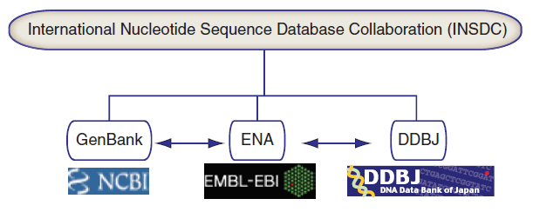
INSDC coordinates sequence data
B&FG 3e
Fig. 2-1
Page 20

Slide 8
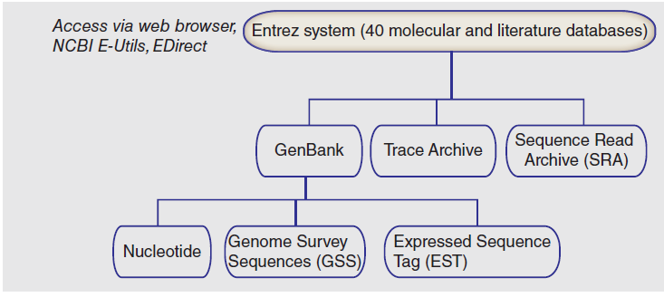
National Center for Biotechnology Information (NCBI): organization
B&FG 3e
Fig. 2-2
Page 21

Slide 9
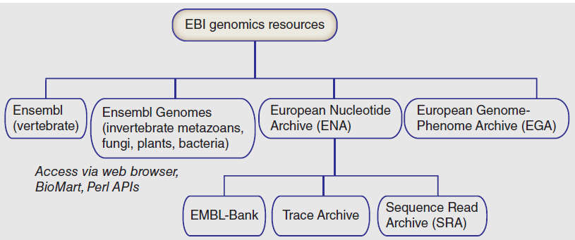
European Bioinformatics Institute (EBI): organization
B&FG 3e
Fig. 2-2
Page 21

Slide 10
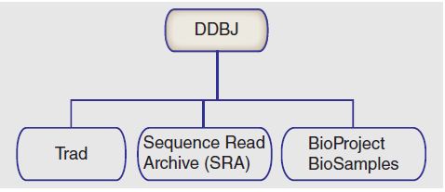
DNA Database of Japan (DDBJ): organization
B&FG 3e
Fig. 2-2
Page 21

Slide 11
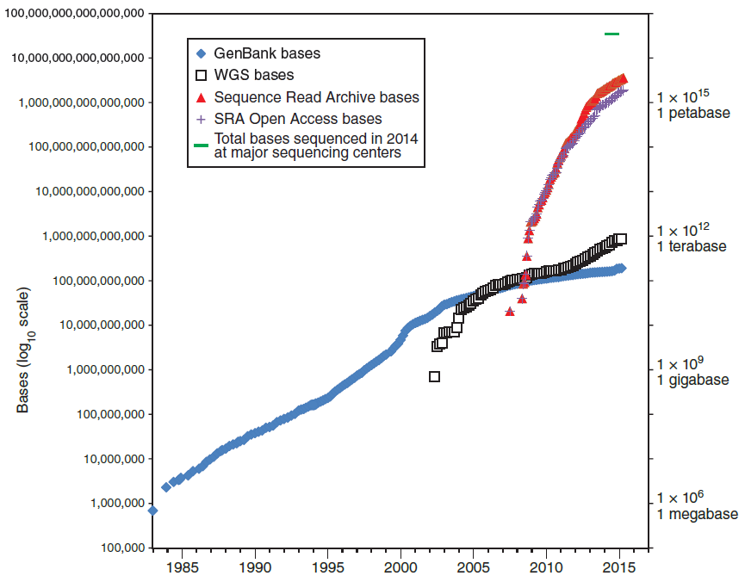
Growth of DNA sequence in repositories
B&FG 3e
Fig. 2-3
Page 22
Year

Slide 12
Growth of DNA sequence in repositories
A vast amount of sequence data has been generated using next-generation sequence technology! (Most are open access, some have human subjects data.)
B&FG 3e
Fig. 2-3
Page 22
Year

Slide 13
Growth of DNA sequence in repositories
Perhaps 40 petabases of DNA were generated in calendar year 2014 at major sequencing centers (see Chapter 15).
B&FG 3e
Fig. 2-3
Page 22
Year

Slide 14
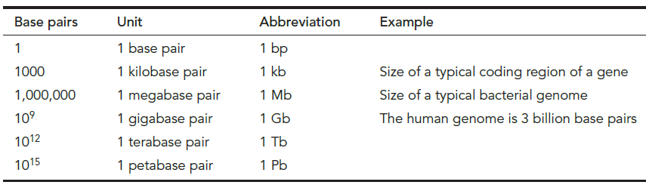
Scales of DNA base pairs
B&FG 3e
Table 2.1
Page 23

Slide 15
Scales of file sizes
Size | Abbrev- iation | # bytes | Example
Bytes | -- | 1 | Single text character
Kilobytes | 1 kb | 10³ | Text file, 1000 characters
Megabytes | 1 MB | 10⁶ | Text file, 1m characters
Gigabytes | 1 GB | 10⁹ | Size of GenBank: 600 GB
Terabytes | 1 TB | 10¹² | Size of 1000 Genomes Project: <500 TB
Petabytes | 1 PB | 10¹⁵ | Size of SRA at NCBI: 5 PB
Exabytes | 1 EB | 10¹⁸ | Annual worldwide output: >2 EB
B&FG 3e
Table 2.2
Page 23

Slide 16
Outline
Introduction to biological databases
Centralized databases store DNA sequences
Contents of DNA, RNA, and protein databases
Central bioinformatics resources: NCBI and EBI
Access to information: accession numbers
Access to information via Gene resource at NCBI
Command-line access to data at NCBI
Access to information: genome browsers
Examples of how to access sequence data: individual genes
How to access sets of data: large-scale queries of regions and features
Access to biomedical literature
Perspective

Slide 17
Contents of databases
We can look at the number of taxa (e.g. species) in GenBank; the most sequenced organisms; types of data; and look at a particular example, the UniGene database of expressed sequence tags (ESTs).
B&FG 3e
Page 24

Slide 18
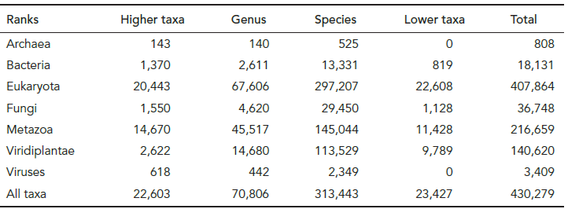
Taxa represented in GenBank (at NCBI)
B&FG 3e
Tab. 2-3
Page 24
http://www.ncbi.nlm.nih.gov/Taxonomy/txstat.cgi

Slide 19
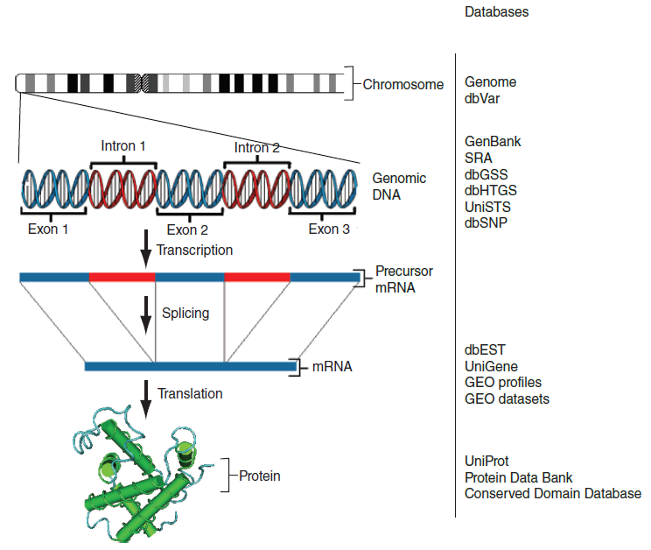
Types of data and examples of databases
B&FG 3e
Fig. 2-4
Page 26

Slide 20
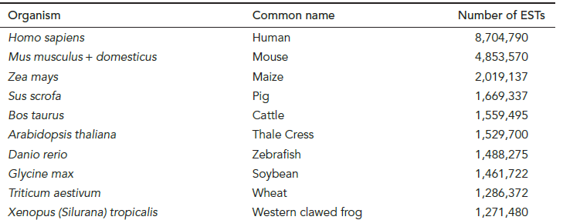
Top ten organisms for which expressed sequence tags (ESTs) have been sequenced
B&FG 3e
Tab. 2-5
Page 28
http://www.ncbi.nlm.nih.gov/dbEST/dbEST_summary.html

Slide 21
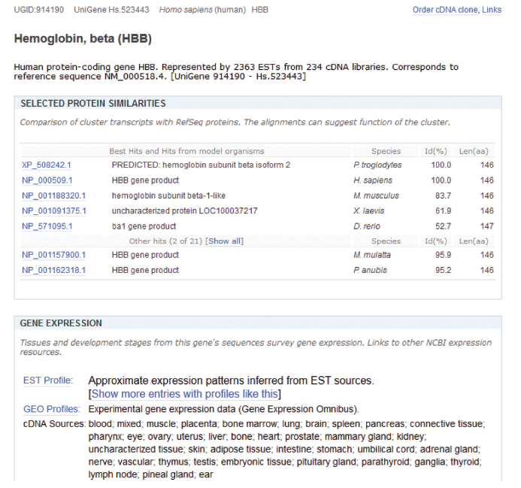
UniGene database: clusters of EST sequences
B&FG 3e
Fig. 2-5
Page 30

Slide 22
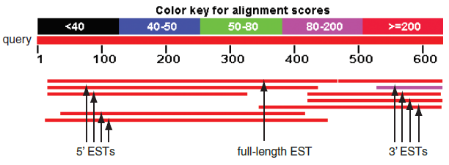
UniGene database: clusters of EST sequences
B&FG 3e
Fig. 2-5
Page 30

Slide 23
Outline
Introduction to biological databases
Centralized databases store DNA sequences
Contents of DNA, RNA, and protein databases
Central bioinformatics resources: NCBI and EBI
Access to information: accession numbers
Access to information via Gene resource at NCBI
Command-line access to data at NCBI
Access to information: genome browsers
Examples of how to access sequence data: individual genes
How to access sets of data: large-scale queries of regions and features
Access to biomedical literature
Perspective

Slide 24
Central bioinformatics resource: NCBI
NCBI (with Ensembl, EBI, UCSC) is one of the central bioinformatics sites. It includes:
PubMed
Entrez search engine integrating ~40 databases
BLAST (Basic Local Alignment Search Tool, Chapters 3-5)
Online Mendelian Inheritance in Man (OMIM, Chapter 21)
Taxonomy
Books
many additional resources
B&FG 3e
Page 31

Slide 25
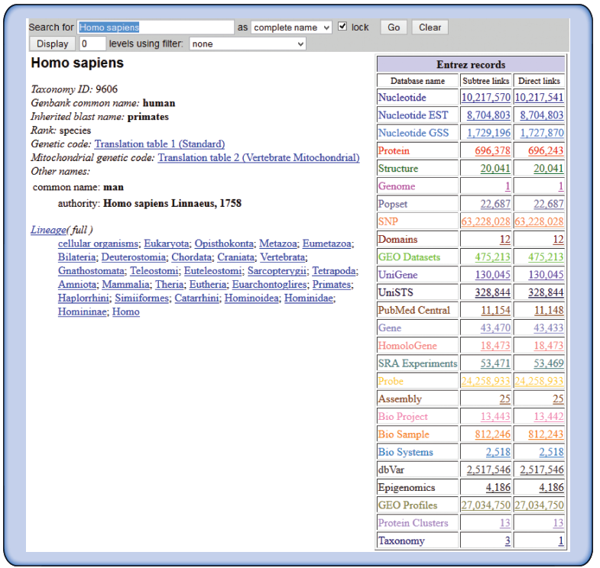
Access to NCBI databases via Taxonomy Browser
Taxonomy offers lineage information, data on rank and genetic code, and convenient Entrez database links
B&FG 3e
Fig. 2-6
Page 33

Slide 26
Outline
Introduction to biological databases
Centralized databases store DNA sequences
Contents of DNA, RNA, and protein databases
Central bioinformatics resources: NCBI and EBI
Access to information: accession numbers
Access to information via Gene resource at NCBI
Command-line access to data at NCBI
Access to information: genome browsers
Examples of how to access sequence data: individual genes
How to access sets of data: large-scale queries of regions and features
Access to biomedical literature
Perspective

Slide 27
Accession numbers are labels for sequences
NCBI includes databases (such as GenBank) that contain information on DNA, RNA, or protein sequences.
You may want to acquire information beginning with a
query such as the name of a protein of interest, or the
raw nucleotides comprising a DNA sequence of interest.
DNA sequences and other molecular data are tagged with accession numbers that are used to identify a sequence
or other record relevant to molecular data.
B&FG 3e
Page 34
Page 26

Slide 28
What is an accession number?
An accession number is a label used to identify a sequence. It is a string of letters and/or numbers that corresponds to a molecular sequence.
Examples:
CH471100.2 GenBank genomic DNA sequence
NC_000001.10 Genomic contig
rs121434231 dbSNP (single nucleotide polymorphism)
AI687828.1 An expressed sequence tag (1 of 184)
NM_001206696 RefSeq DNA sequence (from a transcript)
NP_006138.1 RefSeq protein
CAA18545.1 GenBank protein
O14896 SwissProt protein
1KT7 Protein Data Bank structure record
DNA
RNA
protein
B&FG 3e
Page 34

Slide 29
NCBI’s important RefSeq project:
best representative sequences
RefSeq (accessible via the main page of NCBI)
provides an expertly curated accession number that
corresponds to the most stable, agreed-upon “reference”
version of a sequence.
RefSeq identifiers include the following formats:
Complete genome NC_######
Complete chromosome NC_######
Genomic contig NT_######
mRNA (DNA format) NM_###### e.g. NM_006744
Protein NP_###### e.g. NP_006735
B&FG 3e
Page 34

Slide 30
Outline
Introduction to biological databases
Centralized databases store DNA sequences
Contents of DNA, RNA, and protein databases
Central bioinformatics resources: NCBI and EBI
Access to information: accession numbers
Access to information via Gene resource at NCBI
Command-line access to data at NCBI
Access to information: genome browsers
Examples of how to access sequence data: individual genes
How to access sets of data: large-scale queries of regions and features
Access to biomedical literature
Perspective

Slide 31
Access to sequences: Gene resource at NCBI
NCBI Gene is a great starting point: it collects
key information on each gene/protein from
major databases. It covers all major organisms.
RefSeq provides a curated, optimal accession number for each DNA (NM_000518 for beta globin DNA corresponding to mRNA) or protein (NP_000509)
B&FG 3e
Page 38

Slide 32
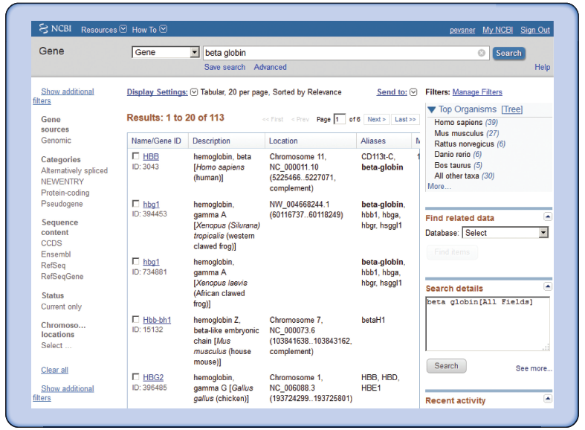
NCBI Gene: example of query for beta globin
B&FG 3e
Fig. 2.8
Page 38

Slide 33
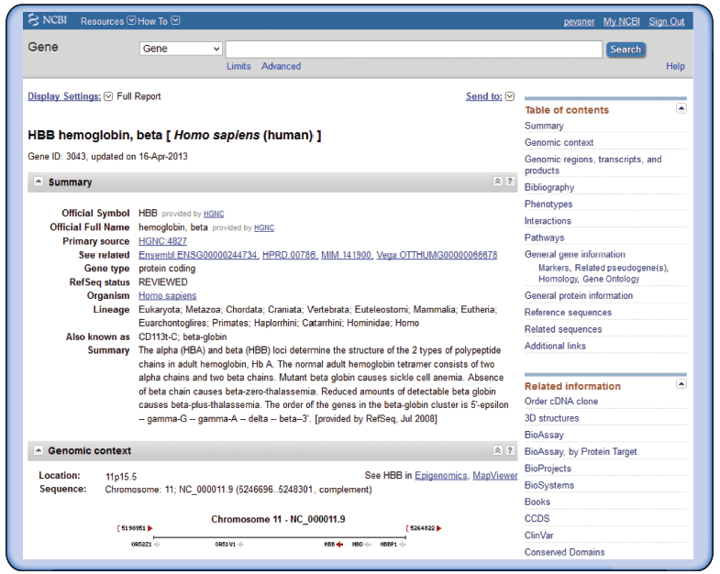
NCBI Gene: example of query for beta globin
B&FG 3e
Fig. 2.9
Page 39

Slide 34
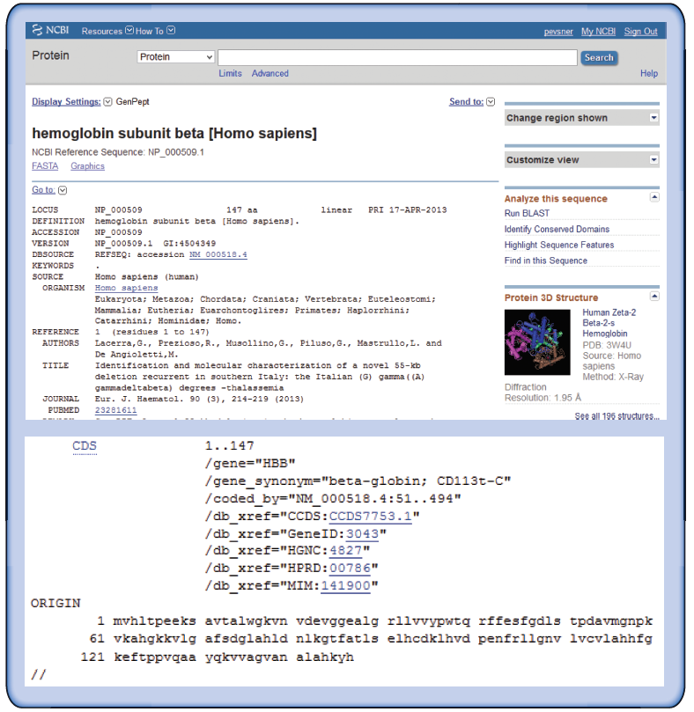
NCBI Protein: hemoglobin subunit beta
B&FG 3e
Fig. 2.10
Page 40

Slide 35
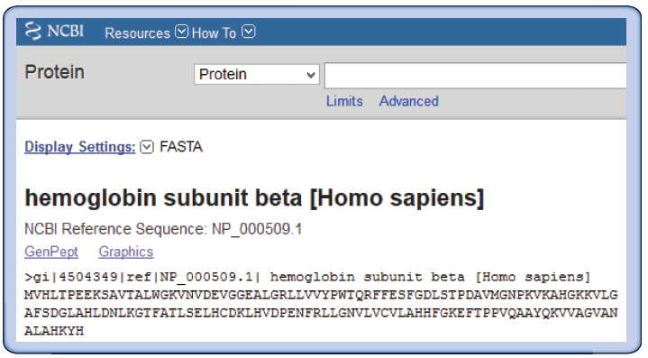
NCBI Protein: hemoglobin subunit beta
in the FASTA format
B&FG 3e
Fig. 2.11
Page 41

Slide 36
Outline
Introduction to biological databases
Centralized databases store DNA sequences
Contents of DNA, RNA, and protein databases
Central bioinformatics resources: NCBI and EBI
Access to information: accession numbers
Access to information via Gene resource at NCBI
Command-line access to data at NCBI
Access to information: genome browsers
Examples of how to access sequence data: individual genes
How to access sets of data: large-scale queries of regions and features
Access to biomedical literature
Perspective

Slide 37
Access to sequences: Gene resource at NCBI
NCBI Gene is a great starting point: it collects
key information on each gene/protein from
major databases. It covers all major organisms.
RefSeq provides a curated, optimal accession number for each DNA (NM_000518 for beta globin DNA corresponding to mRNA) or protein (NP_000509)
B&FG 3e
Page 38

Slide 38
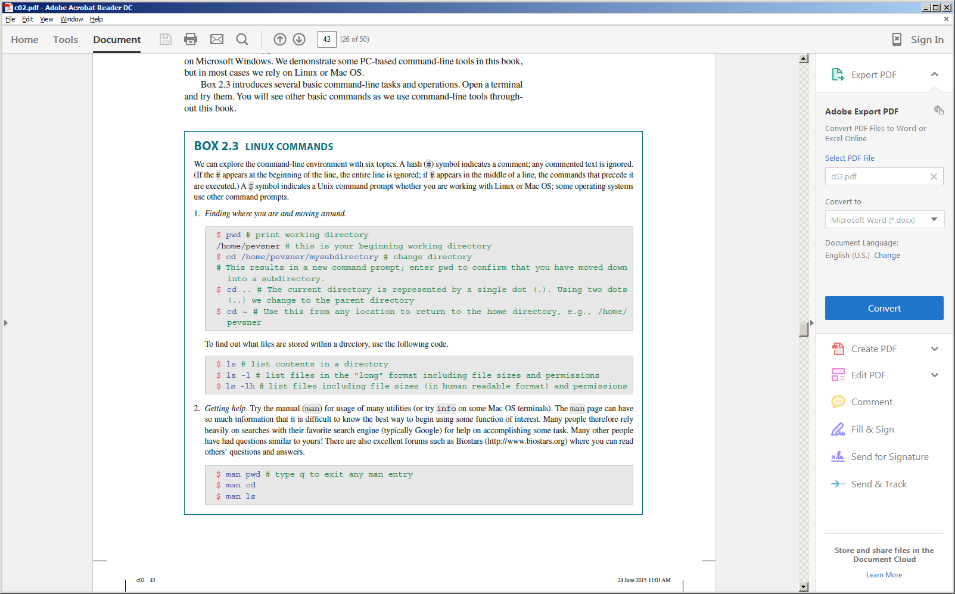
Command-line programs: Linux basics
Finding where you are
Listing files in a directory
Getting help
B&FG 3e
Box 2.3
Page 43

Slide 39
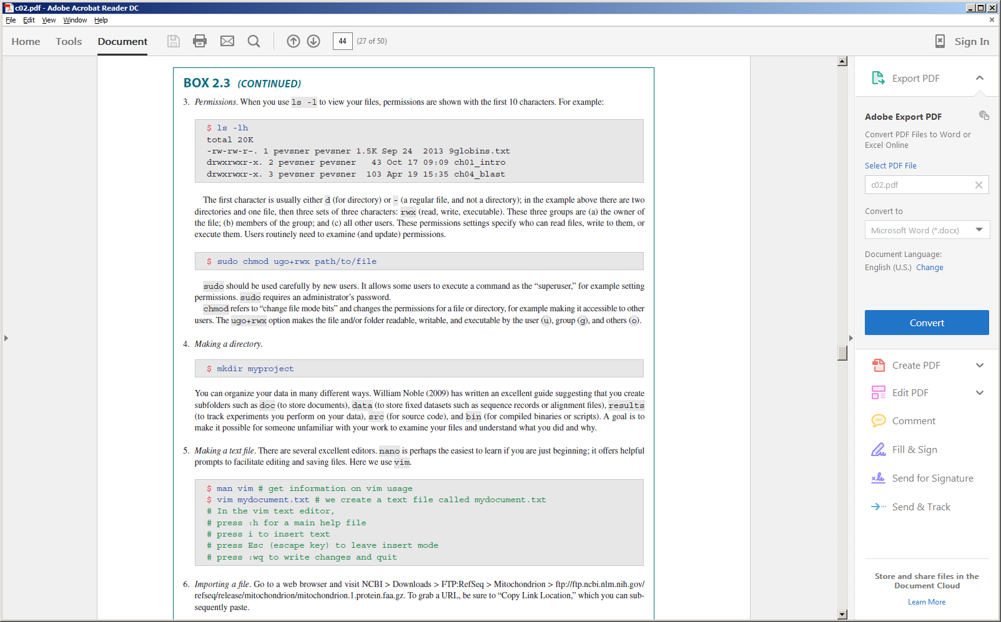
Command-line programs: Linux basics (permissions)
Viewing permissions
file size
file name
rwx for read/write/execute (all other users)
rwx for read/write/execute (group members)
rwx for read/write/execute (user or owner)
d (directory) or – (file)
Changing permissions
B&FG 3e
Box 2.3
Page 43

Slide 40
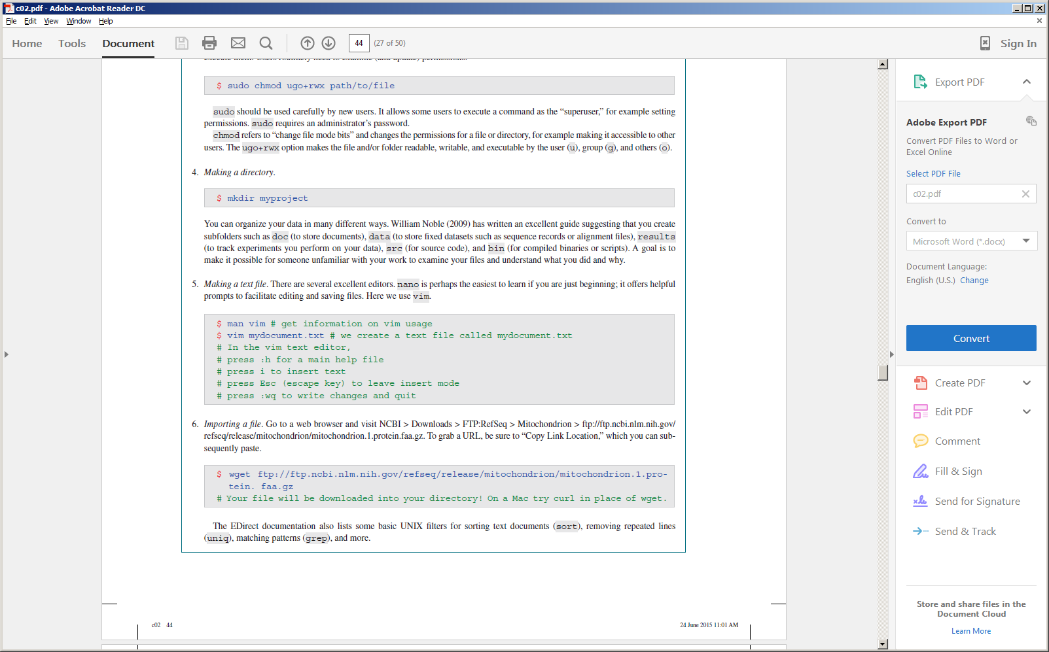
Command-line programs: Linux basics
Making a directory
Making a text file
Importing a file from a website
B&FG 3e
Box 2.3
Page 43

Slide 41
Command-line programs: Linux basics
Other basic Linux commands:
sort
uniq
grep
cut
Many bioinformatics problems require the use of these programs to manipulate files!
B&FG 3e
Box 2.3
Page 43

Slide 42
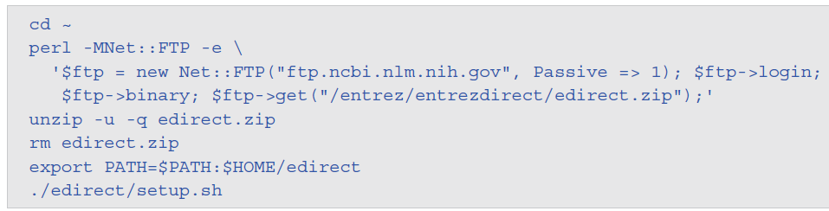
EDirect: command-line access to NCBI databases
Visit the EDirect website at NCBI for installation instructions.
Try it on a Linux machine, on a Mac OS/X (using terminal)! You can also try it on a PC by installing Cygwin.
B&FG 3e
Page 46

Slide 43
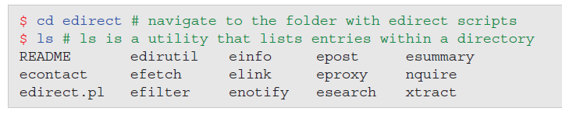
EDirect: command-line access to NCBI databases
EDirect programs include:
Einfo: database statistics.
Esearch: text searches. When you provide a text query (such as “globin”) this returns a list of UIDs. These UIDs can later be used in Esummary, Efetch, or Elink.
Epost: UID uploads. You may have a list of UIDs, such as PMIDs for a favorite query.
Esummary: document summary downloads.
Efetch: data record downloads.
Elink: Entrez links.
B&FG 3e
Box 2.4
Page 45

Slide 44
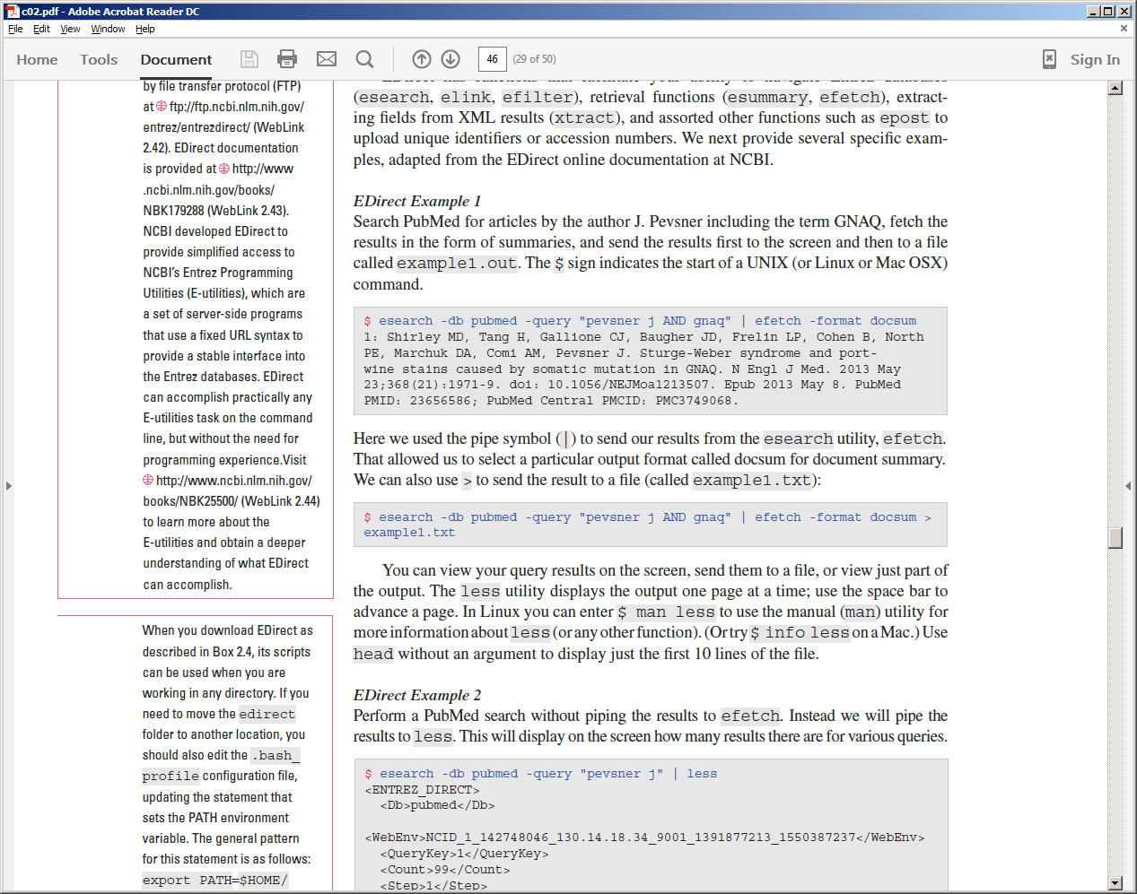
EDirect example 1: PubMed search (result to a file)
Use the esearch utility to query PubMed for articles by J. Pevsner including the term gnaq. Use the pipe (|) command to send the result(s) to the efetch utility, allowing us to select the output format.
You can also repeat this search using the > modifier to send the output to a text file (here called example1.txt).
B&FG 3e
Page 46

Slide 45
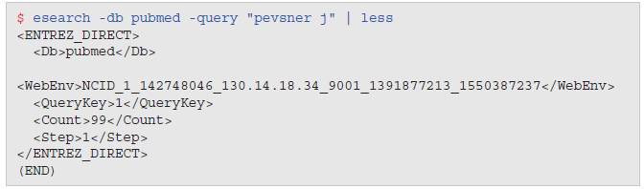
EDirect example 2: PubMed search (result to screen)
You can send an EDirect query to the screen (or to a file) summarizing the results of a query. Here a PubMed query includes <Count>99 indicating that there are 99 items.
B&FG 3e
Page 46

Slide 46
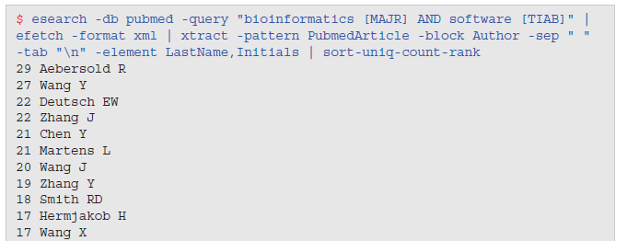
EDirect example 3: PubMed search (prolific authors)
Search PubMed with esearch; send the results to efetch to obtain output formatted in XML; xtract patterns; send the results to a script (provided by NCBI) to sort the results. Here we find the authors with the most publications on bioinformatics software.
B&FG 3e
Page 47

Slide 47
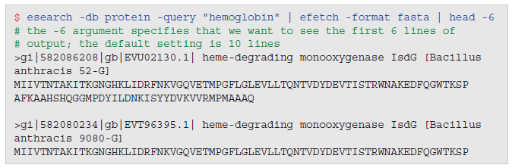
EDirect example 4: globin proteins in FASTA format
Use esearch to find hemoglobin proteins; use pipe (|) to efetch to retrieve the proteins in the FASTA format; use head to display six lines of the output
B&FG 3e
Page 47

Slide 48
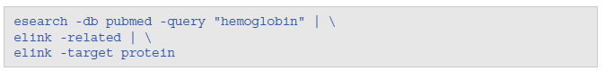
EDirect example 5: combined PubMed + protein search
Send an esearch PubMed query to an elink search for related proteins
B&FG 3e
Page 48

Slide 49
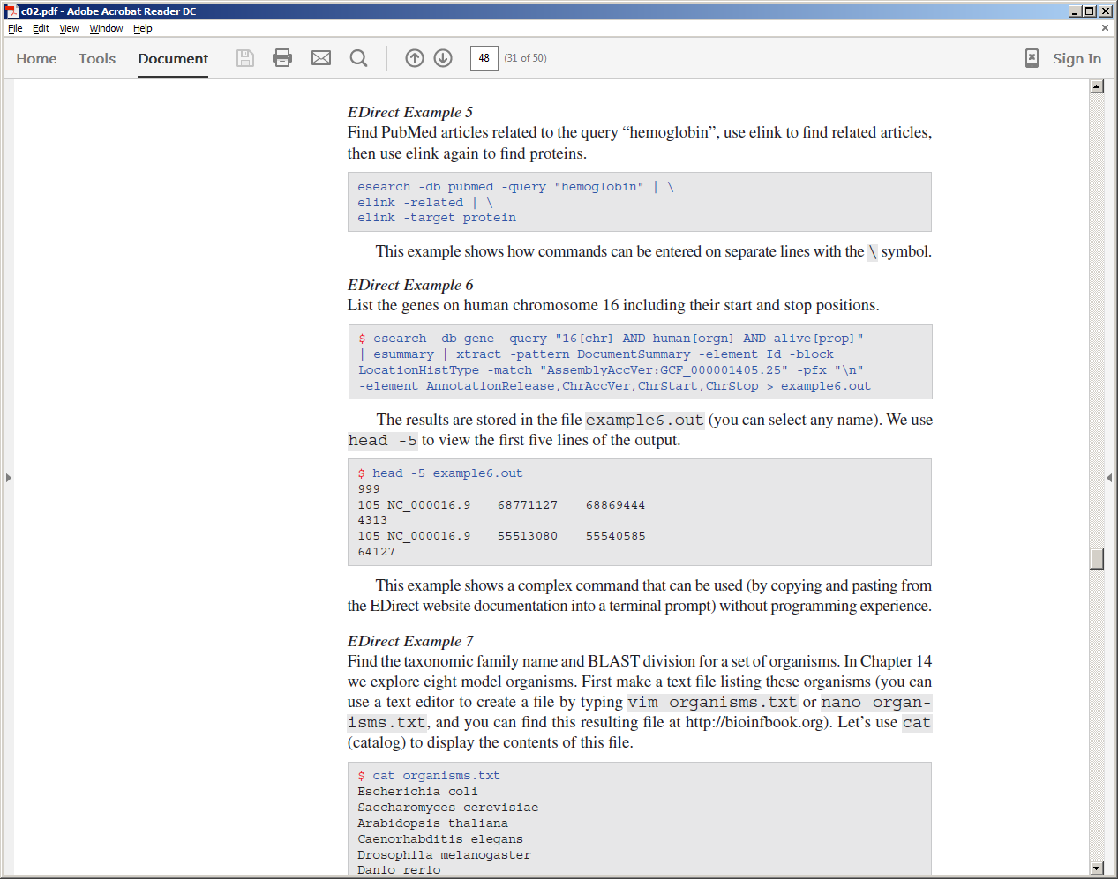
EDirect example 6: genes on a chromosome
Use esearch to find human genes on chromosome 16; use xtract to extract start and stop positions; use > to send the output to a file (called example6.out)
Use head -5 to view just the first five lines of the resulting file
B&FG 3e
Page 48

Slide 50
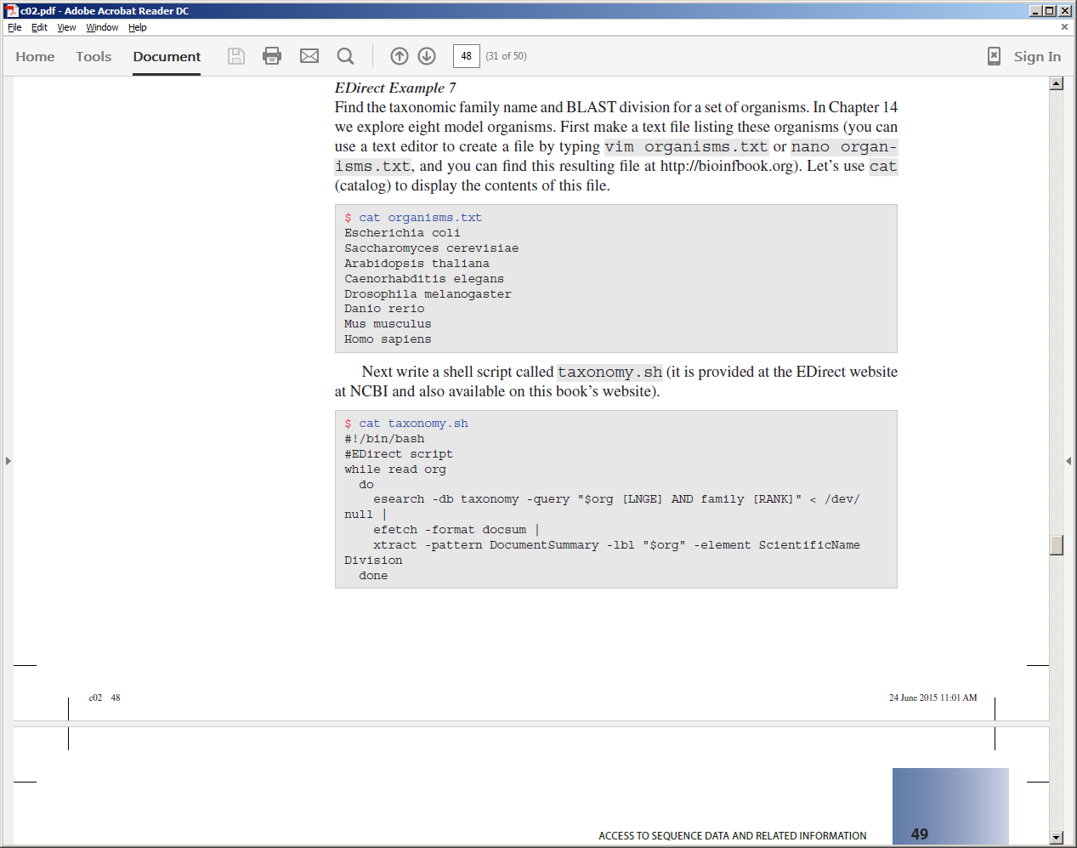
EDirect example 7: taxonomic names
Make a text file of organisms of interest (genus, species)
Write a shell script (courtesy of NCBI; available at bioinfbook.org/chapter2)
B&FG 3e
Page 48

Slide 51
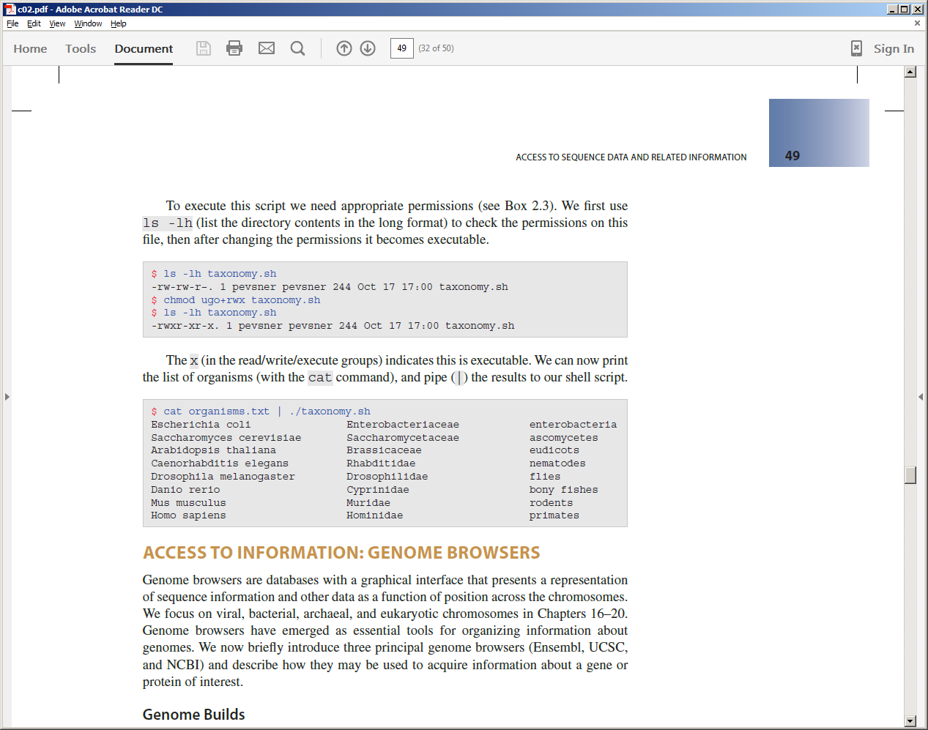
EDirect example 7: taxonomic names
Set permissions to allow us to execute the shell script
View the output (taxonomic groups)
B&FG 3e
Page 48

Slide 52
Outline
Introduction to biological databases
Centralized databases store DNA sequences
Contents of DNA, RNA, and protein databases
Central bioinformatics resources: NCBI and EBI
Access to information: accession numbers
Access to information via Gene resource at NCBI
Command-line access to data at NCBI
Access to information: genome browsers
Examples of how to access sequence data: individual genes
How to access sets of data: large-scale queries of regions and features
Access to biomedical literature
Perspective

Slide 53
Genome Browsers
Versatile tools to visualize chromosomal positions (typically on x-axis) with annotation tracks (typically on y-axis).
Useful to explore data related to some chromosomal feature of interest such as a gene.
Prominent browsers are at Ensembl, UCSC, and NCBI.
Many hundreds of specialized genome browsers are available, some for particular organisms or molecule types.
B&FG 3e
Page 49

Slide 54
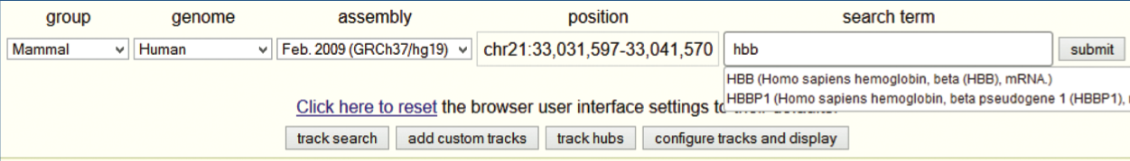
Genome Browsers: UCSC
Choose the group (e.g. mammal), genome (e.g. human), assembly (e.g. GRCh37 or GRCh38), position and/or search term (e.g. hbb).
A genome build or assembly (e.g. GRCh37 or GRCh38) refers to a fixed, agreed-upon version of a reference genome. Assemblies are typically updated every few years (see Chapter 15 for more information).
B&FG 3e
Fig. 2.12
Page 51

Slide 55
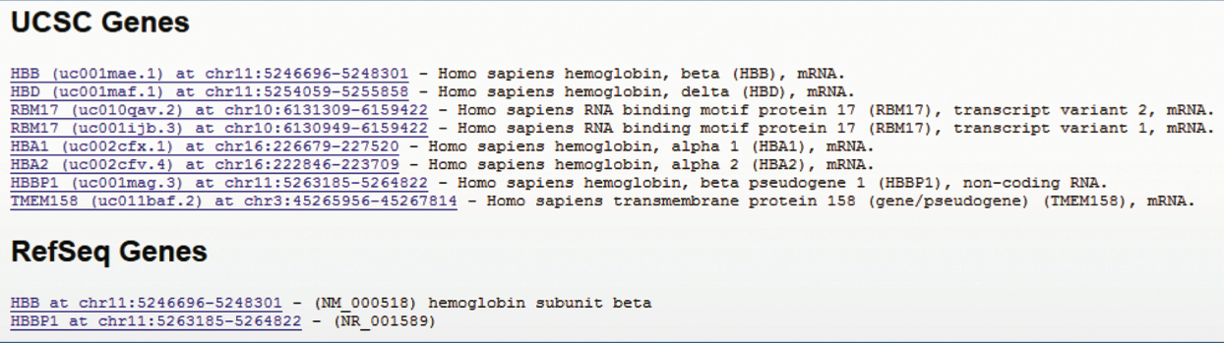
Genome Browsers: UCSC
When you enter a query such as “hbb” you may have to specify which entry you want, such as the RefSeq version having accession NM_000518.
B&FG 3e
Fig. 2.12
Page 51

Slide 56
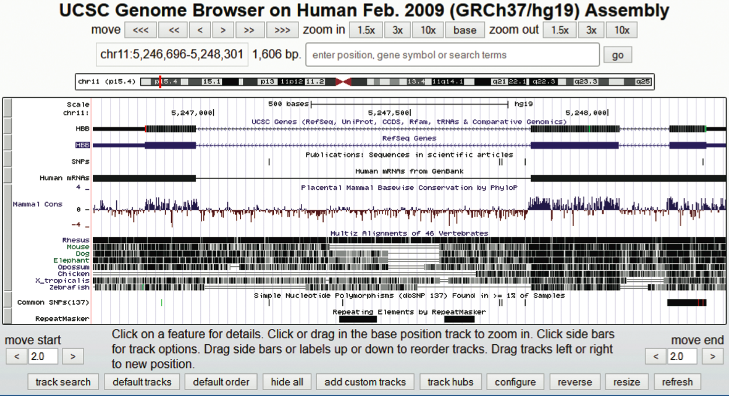
Genome Browsers: UCSC
Explore the browser! Begin with a favorite gene or region. Zoom in to base pair level, then out to full chromosome level. Explore the many tracks you can add.
B&FG 3e
Fig. 2.12
Page 51

Slide 57
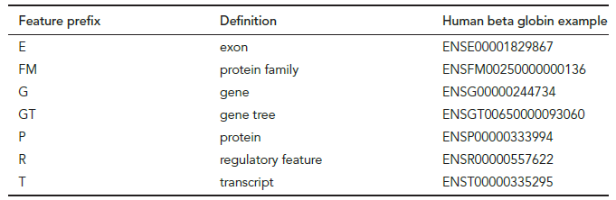
Ensembl stable identifiers
B&FG 3e
Table 2.9
Page 52

Slide 58
Outline
Introduction to biological databases
Centralized databases store DNA sequences
Contents of DNA, RNA, and protein databases
Central bioinformatics resources: NCBI and EBI
Access to information: accession numbers
Access to information via Gene resource at NCBI
Command-line access to data at NCBI
Access to information: genome browsers
Examples of how to access sequence data: individual genes
How to access sets of data: large-scale queries of regions and features
Access to biomedical literature
Perspective

Slide 59
Accessing sequence data for individual genes
When you search for information about a particular gene, make sure you know the official gene symbol (e.g. visit http://www.genenames.org) and choose the appropriate species.
Some searches are particularly challenging. For example, there are thousands of histones. Use Boolean operators to limit the search results.
Searching for HIV-1 proteins, note that there are vast numbers of protein and DN A results (approaching 1 million entries!) but there is only one RefSeq accession. This highlights the usefulness of the RefSeq project.
B&FG 3e
Page 52

Slide 60
Outline
Introduction to biological databases
Centralized databases store DNA sequences
Contents of DNA, RNA, and protein databases
Central bioinformatics resources: NCBI and EBI
Access to information: accession numbers
Access to information via Gene resource at NCBI
Command-line access to data at NCBI
Access to information: genome browsers
Examples of how to access sequence data: individual genes
How to access sets of data: large-scale queries of regions and features
Access to biomedical literature
Perspective

Slide 61
How to access sets of data:
large-scale queries of regions and features
To search a set of genes try BioMart at Ensembl (http://www.ensembl.org). We will explore this further in Chapter 8.
You can also use the UCSC Table Browser. This is complementary to the UCSC Genome Browser. Its output is tabular rather than graphical. Instead of guessing how many elements are in a particular region, you can get a tabular output describing the number of elements, and the chromosome, start, and stop positions.
B&FG 3e
Fig. 2-3
Page 22

Slide 62
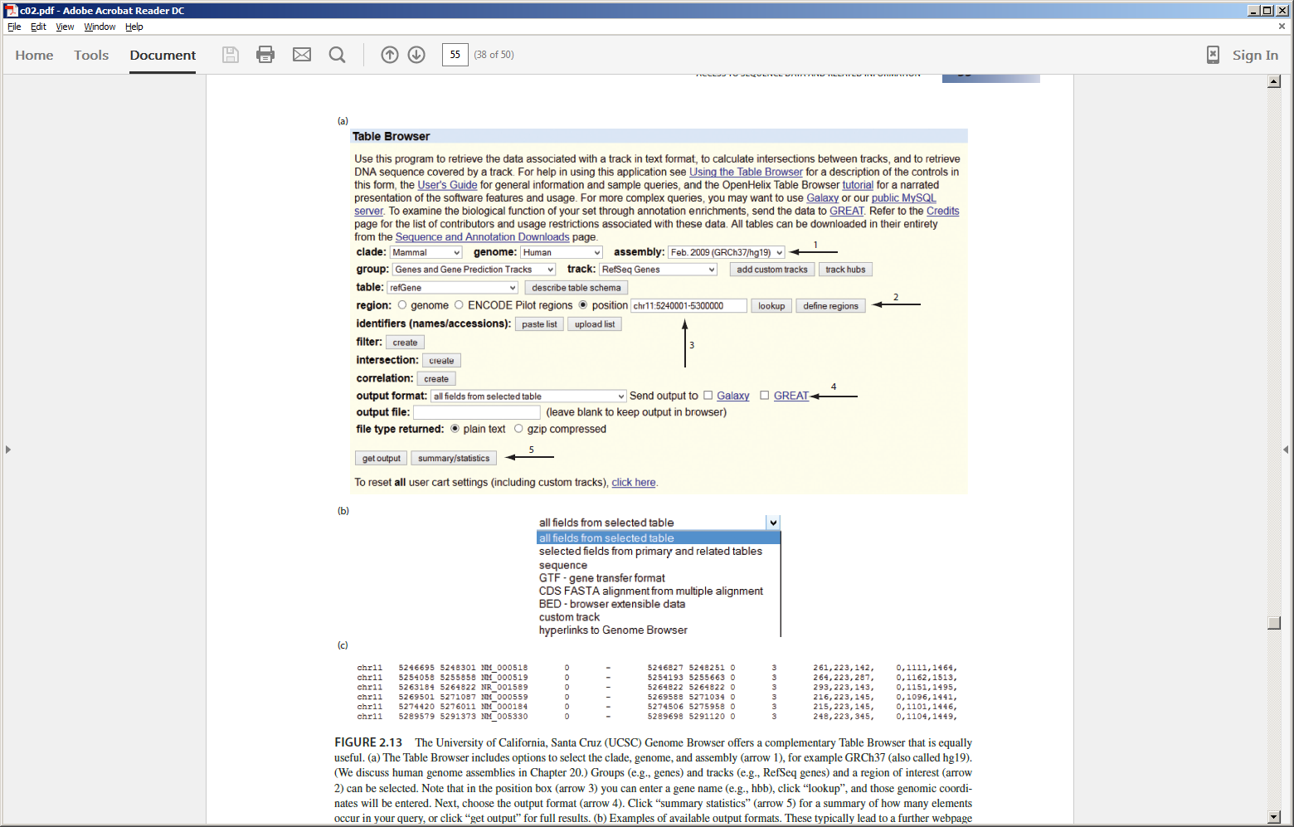
UCSC Table Browser: complementary to genome browser
B&FG 3e
Fig. 2.13
Page 55

Slide 63
BED format: versatile, popular, useful
BED file output from UCSC Table Browser query for genes on a region of human chromosome 11
B&FG 3e
Fig. 2.13
Page 55

Slide 64
Outline
Introduction to biological databases
Centralized databases store DNA sequences
Contents of DNA, RNA, and protein databases
Central bioinformatics resources: NCBI and EBI
Access to information: accession numbers
Access to information via Gene resource at NCBI
Command-line access to data at NCBI
Access to information: genome browsers
Examples of how to access sequence data: individual genes
How to access sets of data: large-scale queries of regions and features
Access to biomedical literature
Perspective

Slide 65
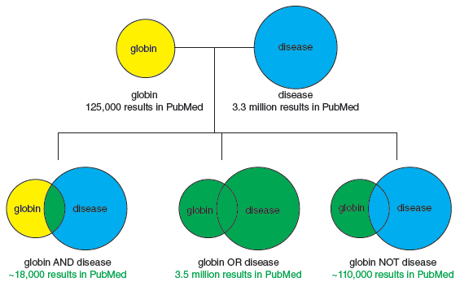
Venn diagrams of Boolean operators AND, OR, NOT
B&FG 3e
Box 2.6
Page 59

Slide 66
Outline
Introduction to biological databases
Centralized databases store DNA sequences
Contents of DNA, RNA, and protein databases
Central bioinformatics resources: NCBI and EBI
Access to information: accession numbers
Access to information via Gene resource at NCBI
Command-line access to data at NCBI
Access to information: genome browsers
Examples of how to access sequence data: individual genes
How to access sets of data: large-scale queries of regions and features
Access to biomedical literature
Perspective

Slide 67
Perspective
The field of bioinformatics is growing quickly, in part because of the introduction of vast amounts of sequence data. There are many databases that store genomic data, and many approaches to extracting information
B&FG 3e
Page 59

